Slide 1
The mind – in your dreams
Basic 07 – Unit 9b

Slide 2
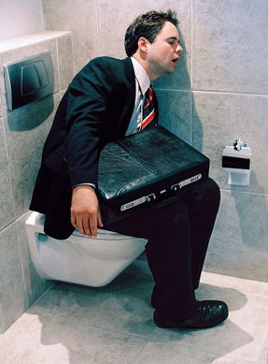
Asleep:
He is asleep

Slide 3
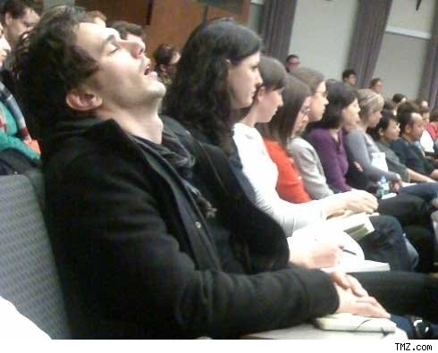
Asleep
He is asleep, but the rest are awake

Slide 4

confusing
This sign is confusing
:s

Slide 5

confusing
This sign is confusing
:s

Slide 6

Thoughts
He has a lot of thoughts in his mind

Slide 7
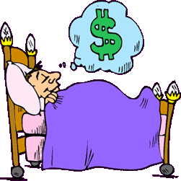
dream
He is dreaming about money

Slide 8
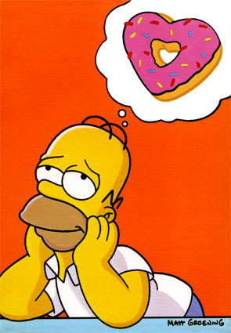
Daydream
He is daydreaming

Slide 9
http://basic07.webs.com/

